Slide 1
Legal Ombudsman
Darren Cox
Ombudsman

Slide 2
LeO Complaints Process
Our business process
Assessment
Investigation
Decision
60,000 contacts
→ 18,000 complaints
7,635
investigated
7,440
resolved
19

Slide 3
Client care - Top 5 Areas of Law

Slide 4
Complaint types 2015/16
 | Delay / failure to progress | Costs | Failure to advise | Failure to follow instructions | Failure to communicate
Residential conveyancing | 20% | 11% | 24% | 17% | 16%
Wills and probate | 23% | 19% | 12% | 14% | 17%
Family | 17% | 28% | 17% | 16% | 13%

Slide 5
Common conveyancing complaints
Delay / Failure to progress
Reason = third party actions (local authority searches, other conveyancers)
Your role = explain the process
Failure to advise
Potential reasons = restrictive covenants (new builds, parking spaces, running a business) and boundary issues
Your role = highlight issues and advise on implications

Slide 6
Common complaints…..
Stamp duty
- Stamp duty mitigation schemes
- Oversight in post-completion work
Early warning of financial problems
Closure of firms

Slide 7
New issues in conveyancing
Cybercrime and fraud
Take reasonable precautions:
your own processes
informing consumers
Follow regulator guidance
- http://www.conveyancer.org.uk/CLC-Lawyer/Tackling-Cybercrime.aspx

Slide 8
Remedies
Questions:
Has there been poor service?
Has poor service led to any specific loss or disadvantage to the customer?
Can we put the customer back in the position they would have been in?
What remedy is appropriate?

Slide 9
Remedies
Award | Rationale
Modest £50 - £250 | Impact of poor service was short-lived and no longer exists
Significant £250 - £750 | Impact of poor service was serious but not permanent
Serious £750 + | Impact of poor service was long-term and affected customer’s wellbeing or life
http://www.legalombudsman.org.uk/?portfolio=guidance-our-approach-to-remedies

Slide 10
Complaints handling – regulatory requirements
LSB requires that consumers understand their right to…
complain to their lawyer
escalate a complaint to the Legal Ombudsman
And so poor complaints handling can lead to…
    Potential case fee
    Misconduct referral to the regulator
    Customers coming to the Legal Ombudsman

Slide 11
From a consumer perspective
Concerns about:
- Impact on existing case
Impact on relationship
Is it worth complaining about a lawyer
How to complain
So…. if you were a consumer:
- Would you know your firm had a complaints handling procedure?
- How easy would it be to find?
- If you phoned reception, how would they respond to the complaint?
- Would you think your firms procedure was too complex?
- Does your procedure encourage consumers to raise concerns?

Slide 12
From a lawyer perspective
Would you recognise a complaint?
“Expression of Dissatisfaction” (Scheme Rules s1.6)
Is it clear how to respond?
- What issues can lawyers deal with themselves?
- When should they escalate issues or start the formal complaints process?
- Is there help with challenging situations?
- Are there any early warning systems in place?

Slide 13
Best practice
What does a good response look like?
Tone and language
Maintain a professional and courteous tone.
Clear language, as little jargon as possible.
What are the issues?
Be clear what issues you have considered.
What are your conclusions?
If you disagree with the customers views say so, and your reasons why.
If you agree with any of the issues, acknowledge this, and explain why you agree.
Remember that an apology is not an acknowledgement of liability (scheme rules 5.21)
How do you intend to resolve the complaint?
What can you do to resolve the complaint.
Next steps:
What are the options if the customer disagrees?
If it is your final response, say so, and include full details for the Legal Ombudsman

Slide 14
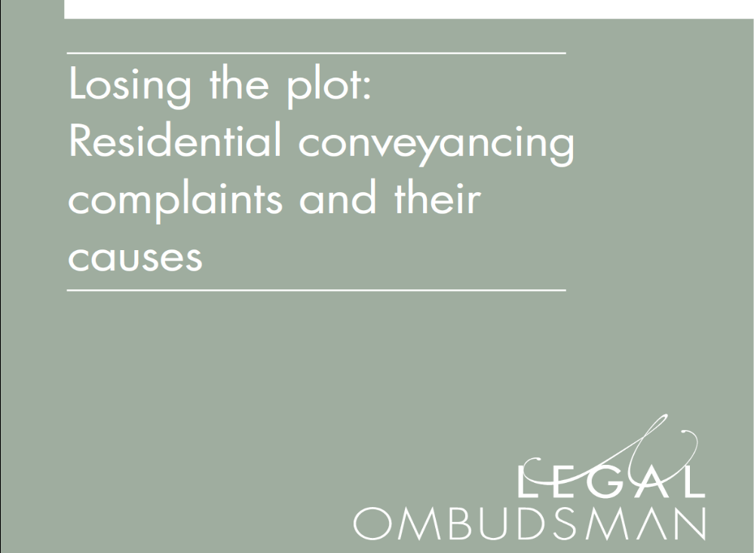


Resources

Slide 15
Complaint handling
Feeding back to the profession
  Attend our complaints handling course – CPD accredited.
  Visit our website for News, Research, Decisions and a dedicated section for Lawyers
  Publications - Thematic reports, guidance and consultations
  LeO news – sign up to receive it through our website
  Social media – LinkedIn and Twitter @Legal_Ombudsman

Slide 16
If you have any feedback or questions please email courses@legalombudsman.org.uk
Feedback and questions

